Slide 1

7DaysChic

Slide 2
Company overview
Who we are
Our platform opens up a world of fashion expertise, granting you access to stylists, designers, tailors, hair artists, and makeup experts from across the globe. You can instantly engage in chats or online meetings with these professionals to enhance your aesthetic appeal.

Slide 3
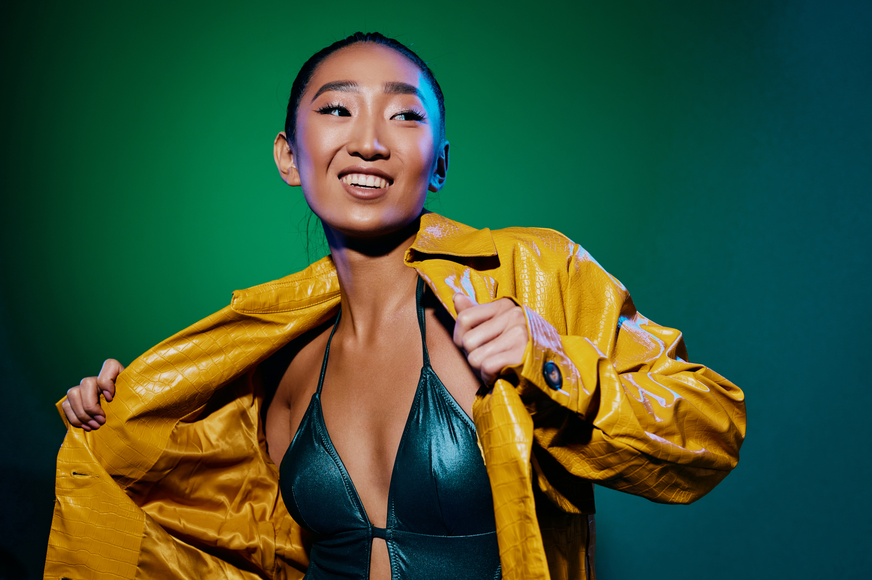
Our focus is on creating tailored interactions that meet the specific needs of models worldwide. Whether you're based in London or elsewhere, our platform enables seamless connections with boutique businesses in cities like Nice, France. By exploring user profiles, models can access a wealth of fashion experiences and personalized styling insights designed to support their professional growth and success.

Slide 4
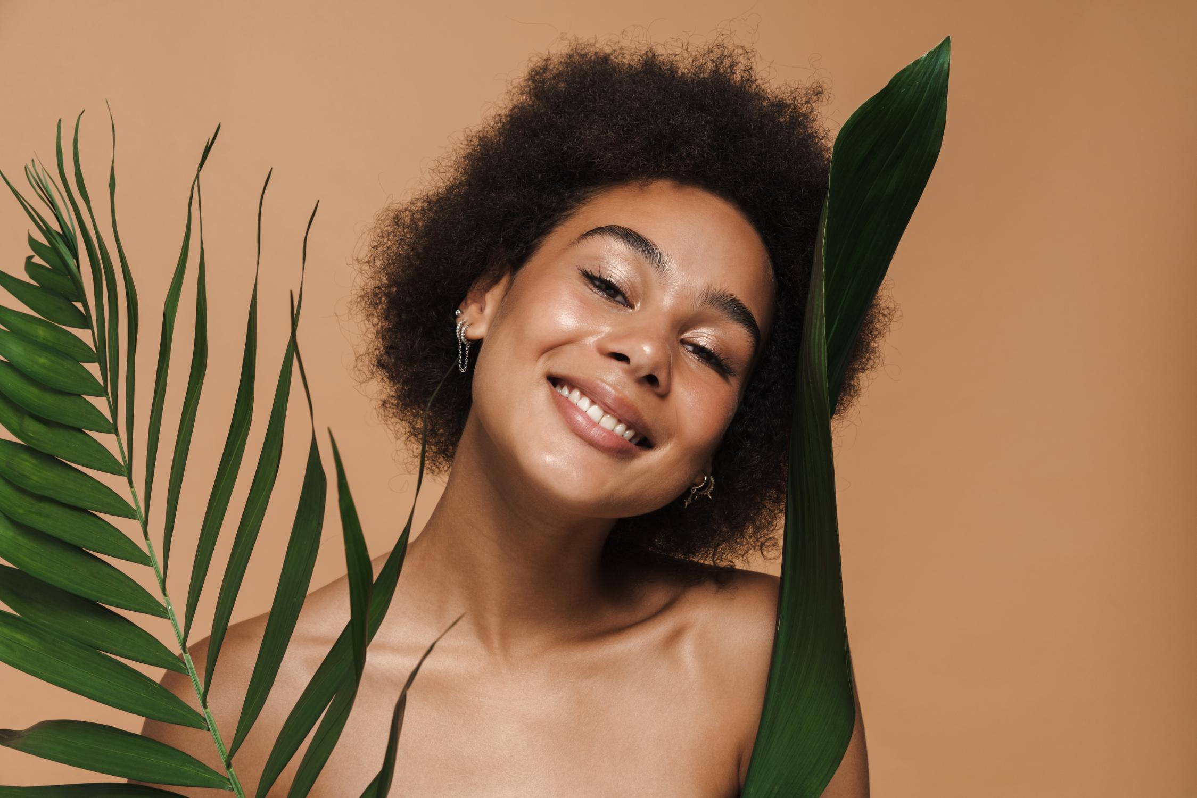
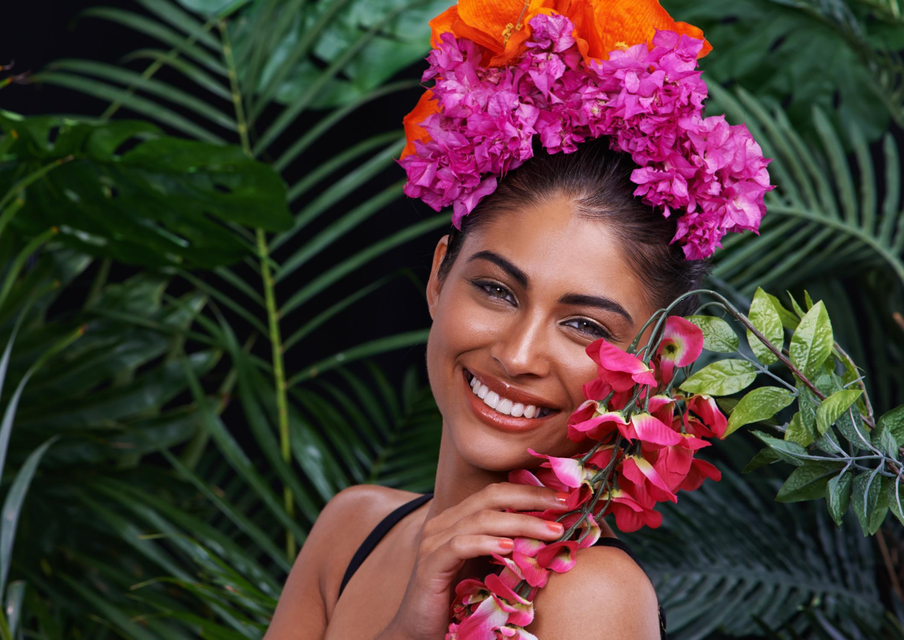
Our Service
Online Consultation
Our online consultation platform connects businesses to a comprehensive network of industry players – from designers and stylists to photographers and makeup artists.

Slide 5
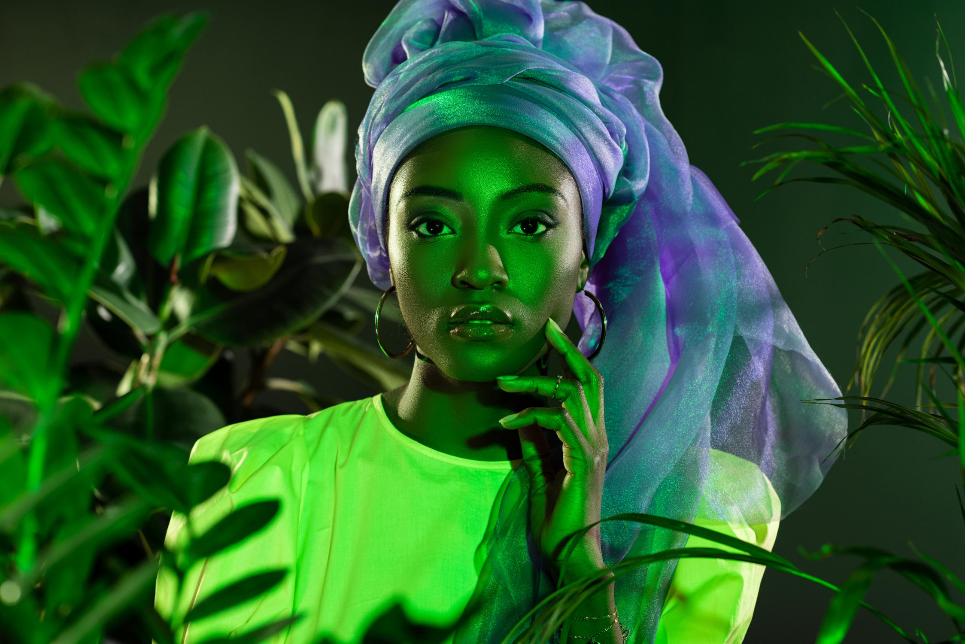
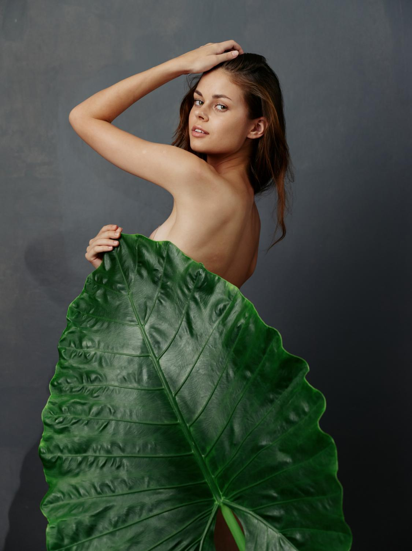
Offline Consultation
The unique selling point of our offline consultation platform is its asynchronous communication feature. Using chat, video messages, or voice messages, you don’t have to be online at the same time as your counterparts.

Slide 6
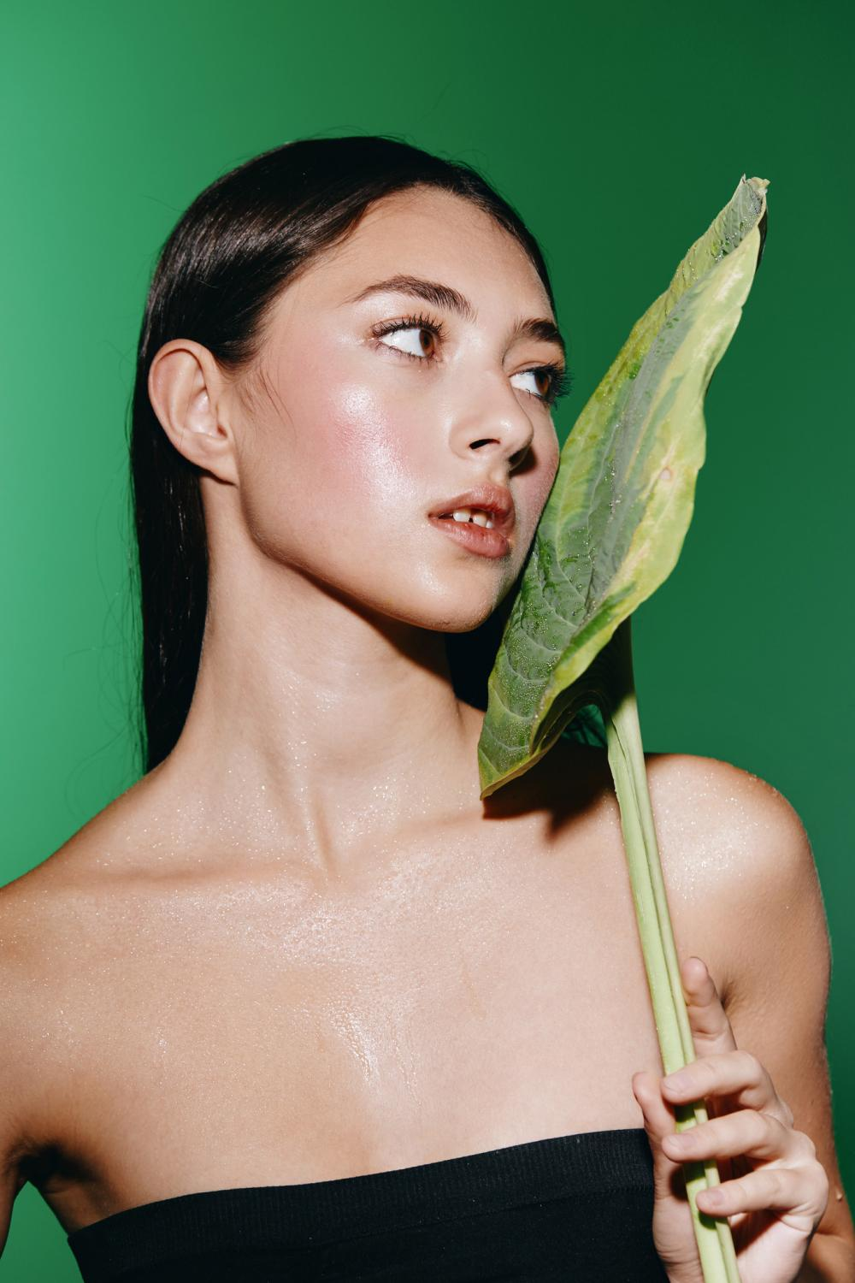
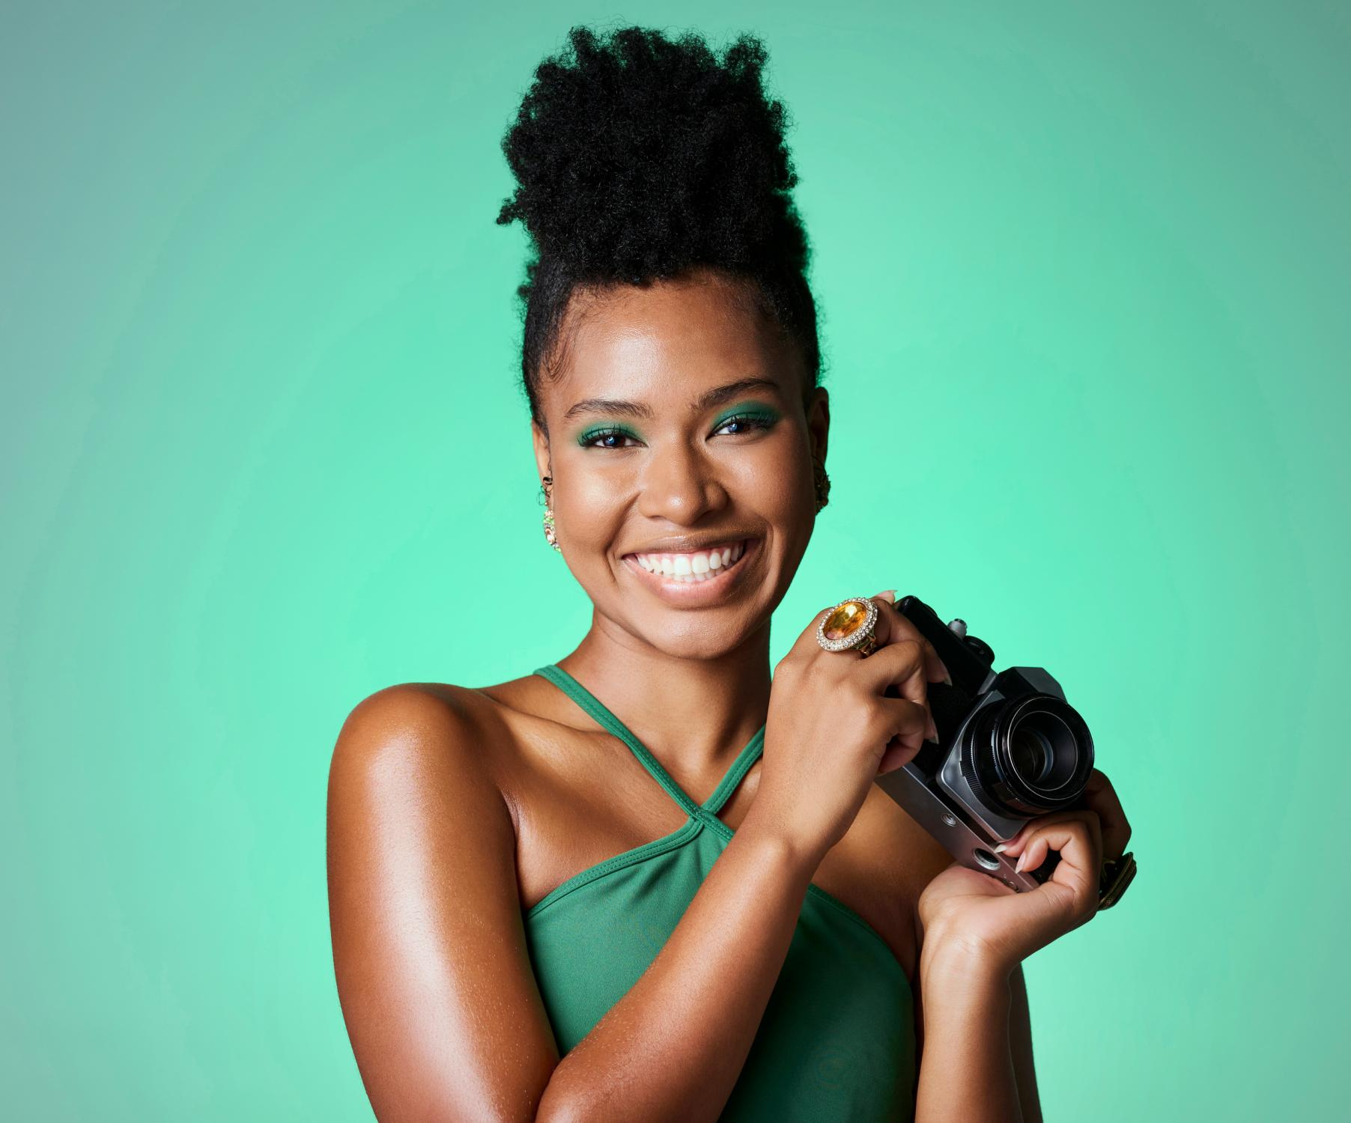
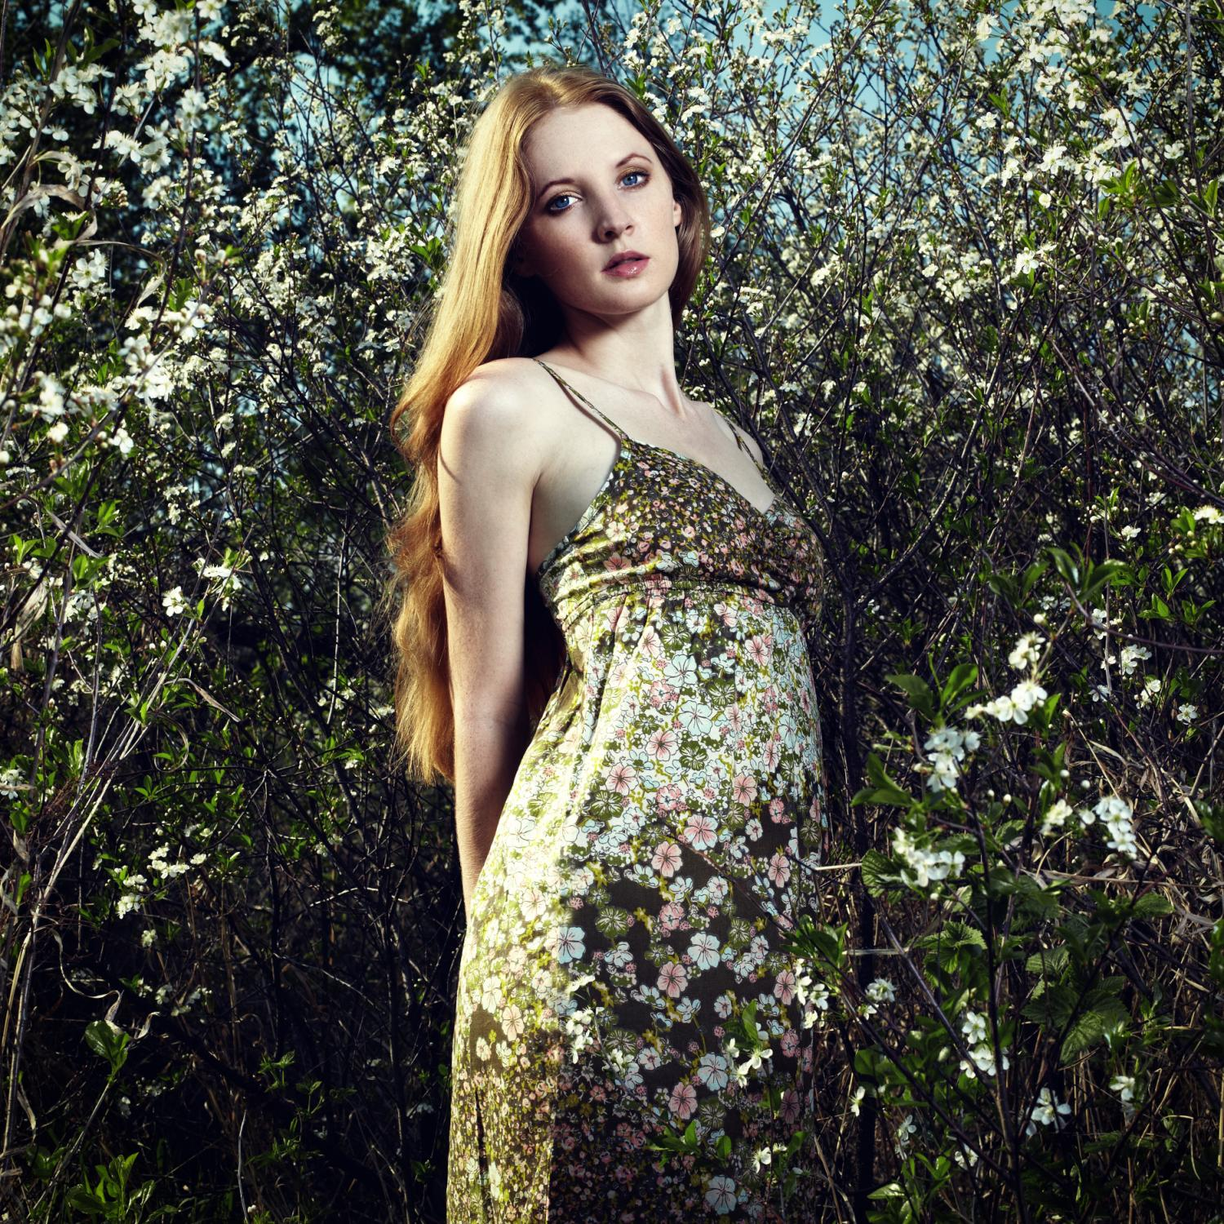
Public Profile
Our “PUBLIC PROFILE” feature is your personalized beacon in the global fashion industry. For beginners and individuals, it offers a platform to realize dreams, showcase growth

Slide 7
Business Profile
The “BUSINESS PROFILE” feature is business’s passport to global recognition and growth in the fashion industry. It allows to exhibit the uniqueness, engage with customers and peers, and even transact business on a global scale.

Slide 8
Translation Service
We translate concepts, ideas, and even the subtlest nuances of fashion terminology. This service ensures that no matter what language you speak or understand, your ideas will not be lost in translation.

Slide 9
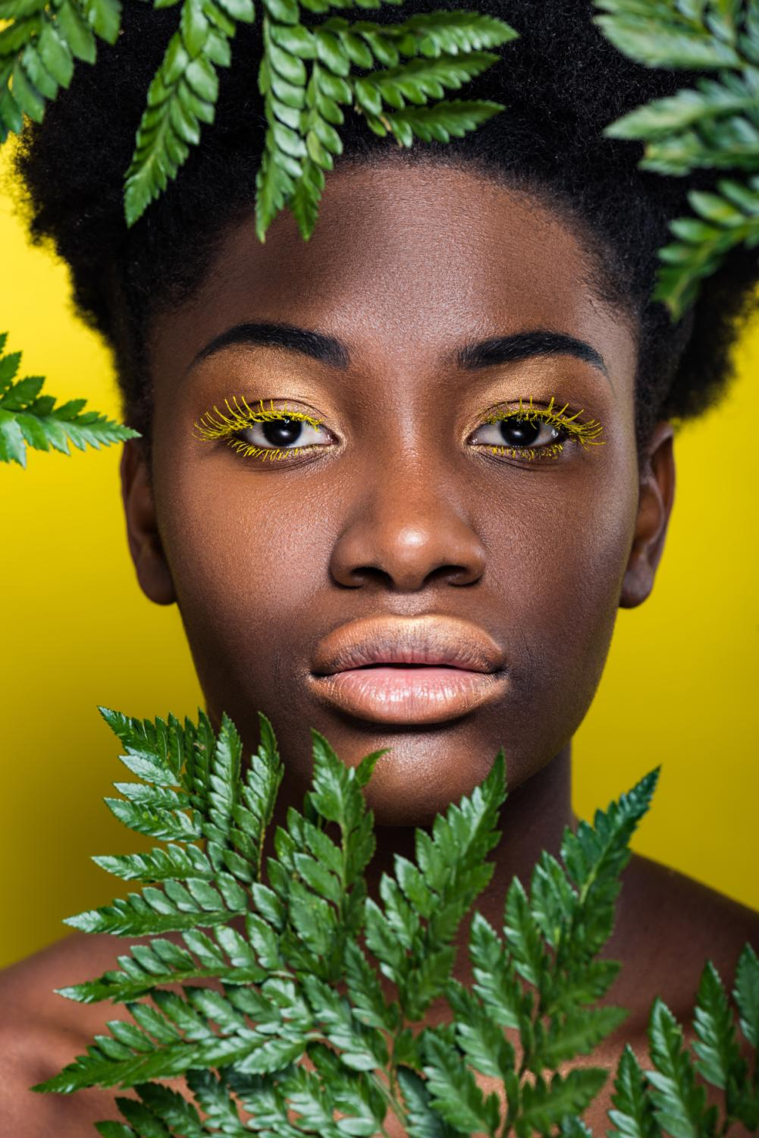
Selling Services
The Service we sell from online style consultations and design sessions to webinars, seminars, or group classes. Our platform also supports offline or face-to-face services. that brings together diverse fashion businesses and industry professionals, from designers and tailors to stylists and models. Our platform offers the flexibility to sell services in various formats. Whether you prefer to offer fixed-price services or operate on an hourly basis

Slide 10
Selling Time
Through our platform,professionals earn by offering their skills and expertise, be it virtual services or in-person engagements. By setting their rates and availability, they can manage their schedules and income efficiently and flexibly.

Slide 11
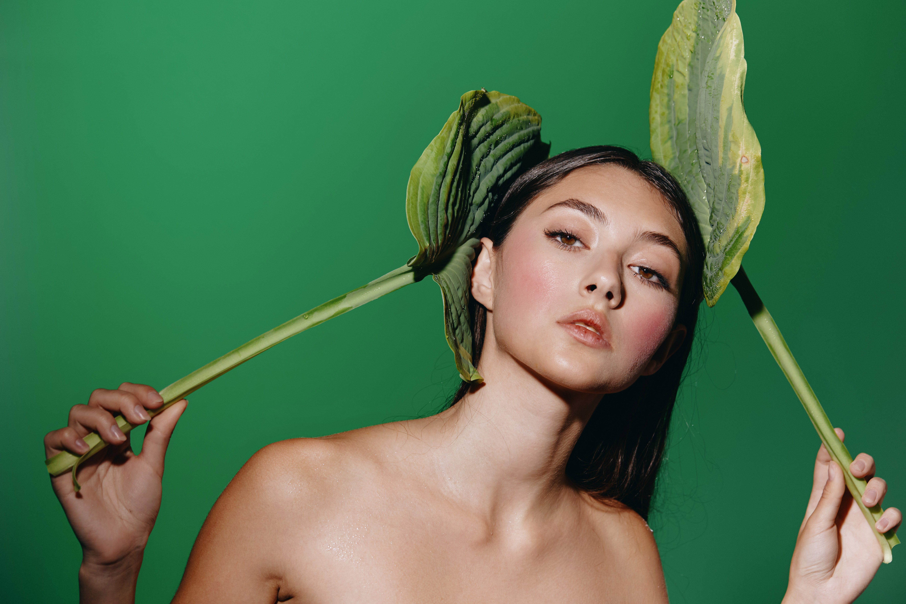
Optimizing your profile with SEO to be visible on web
At 7DaysChic, we specialize in SEO to boost your profile visibility in the fashion industry. Enhance your online presence, attract targeted opportunities, and build a credible, long-term career with us.

Slide 12

Promoting To The Business Network Constantly
At 7DaysChic, we actively promote models to our network, boosting their visibility and fostering key industry relationships for career growth in fashion. Partner with us to enhance your presence and advance in the industry.

Slide 13
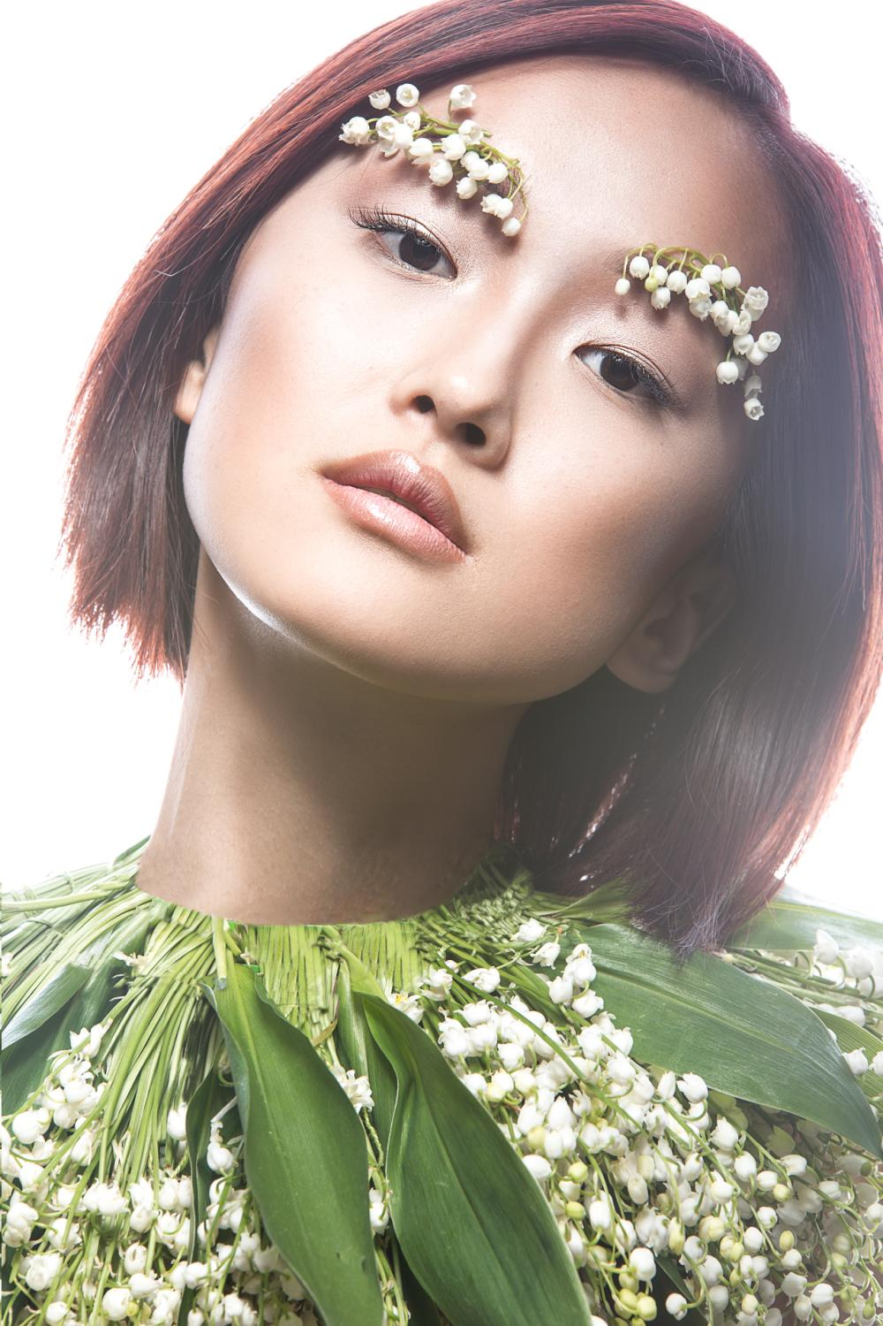
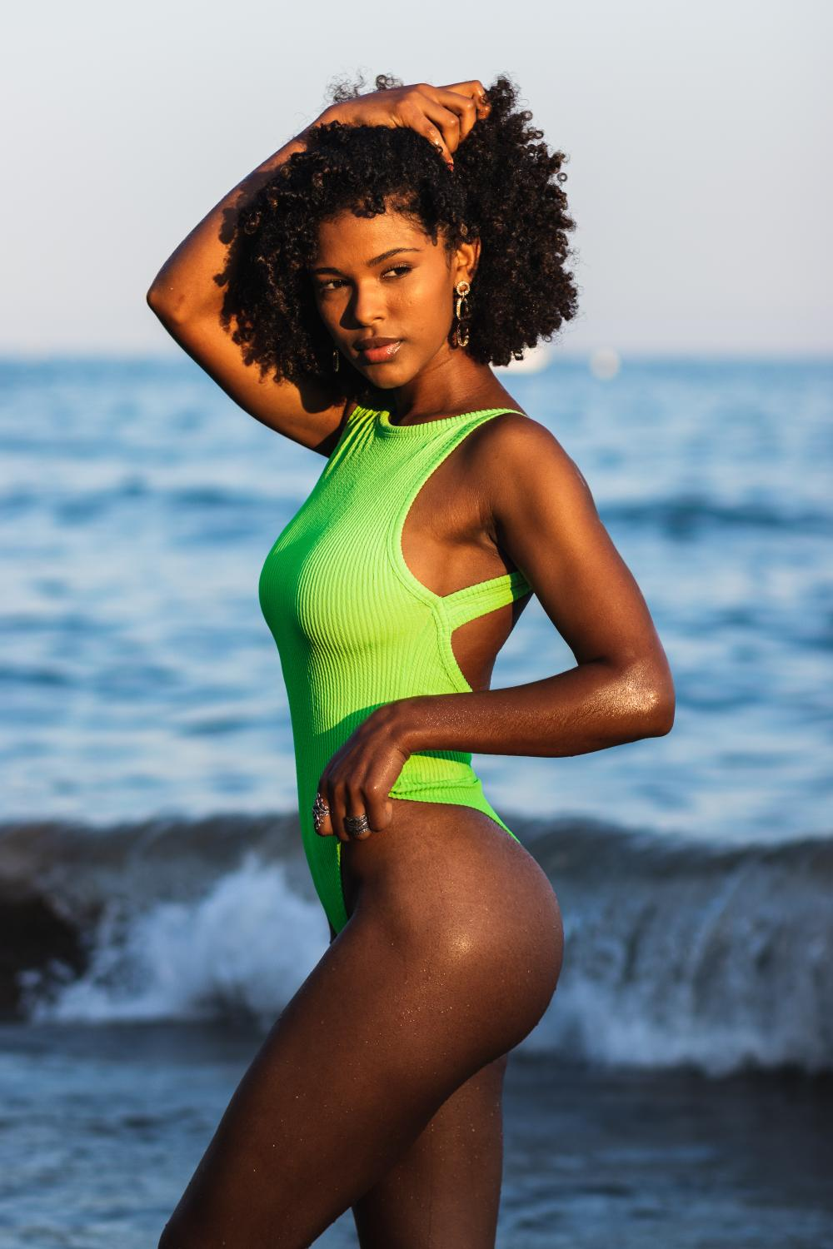
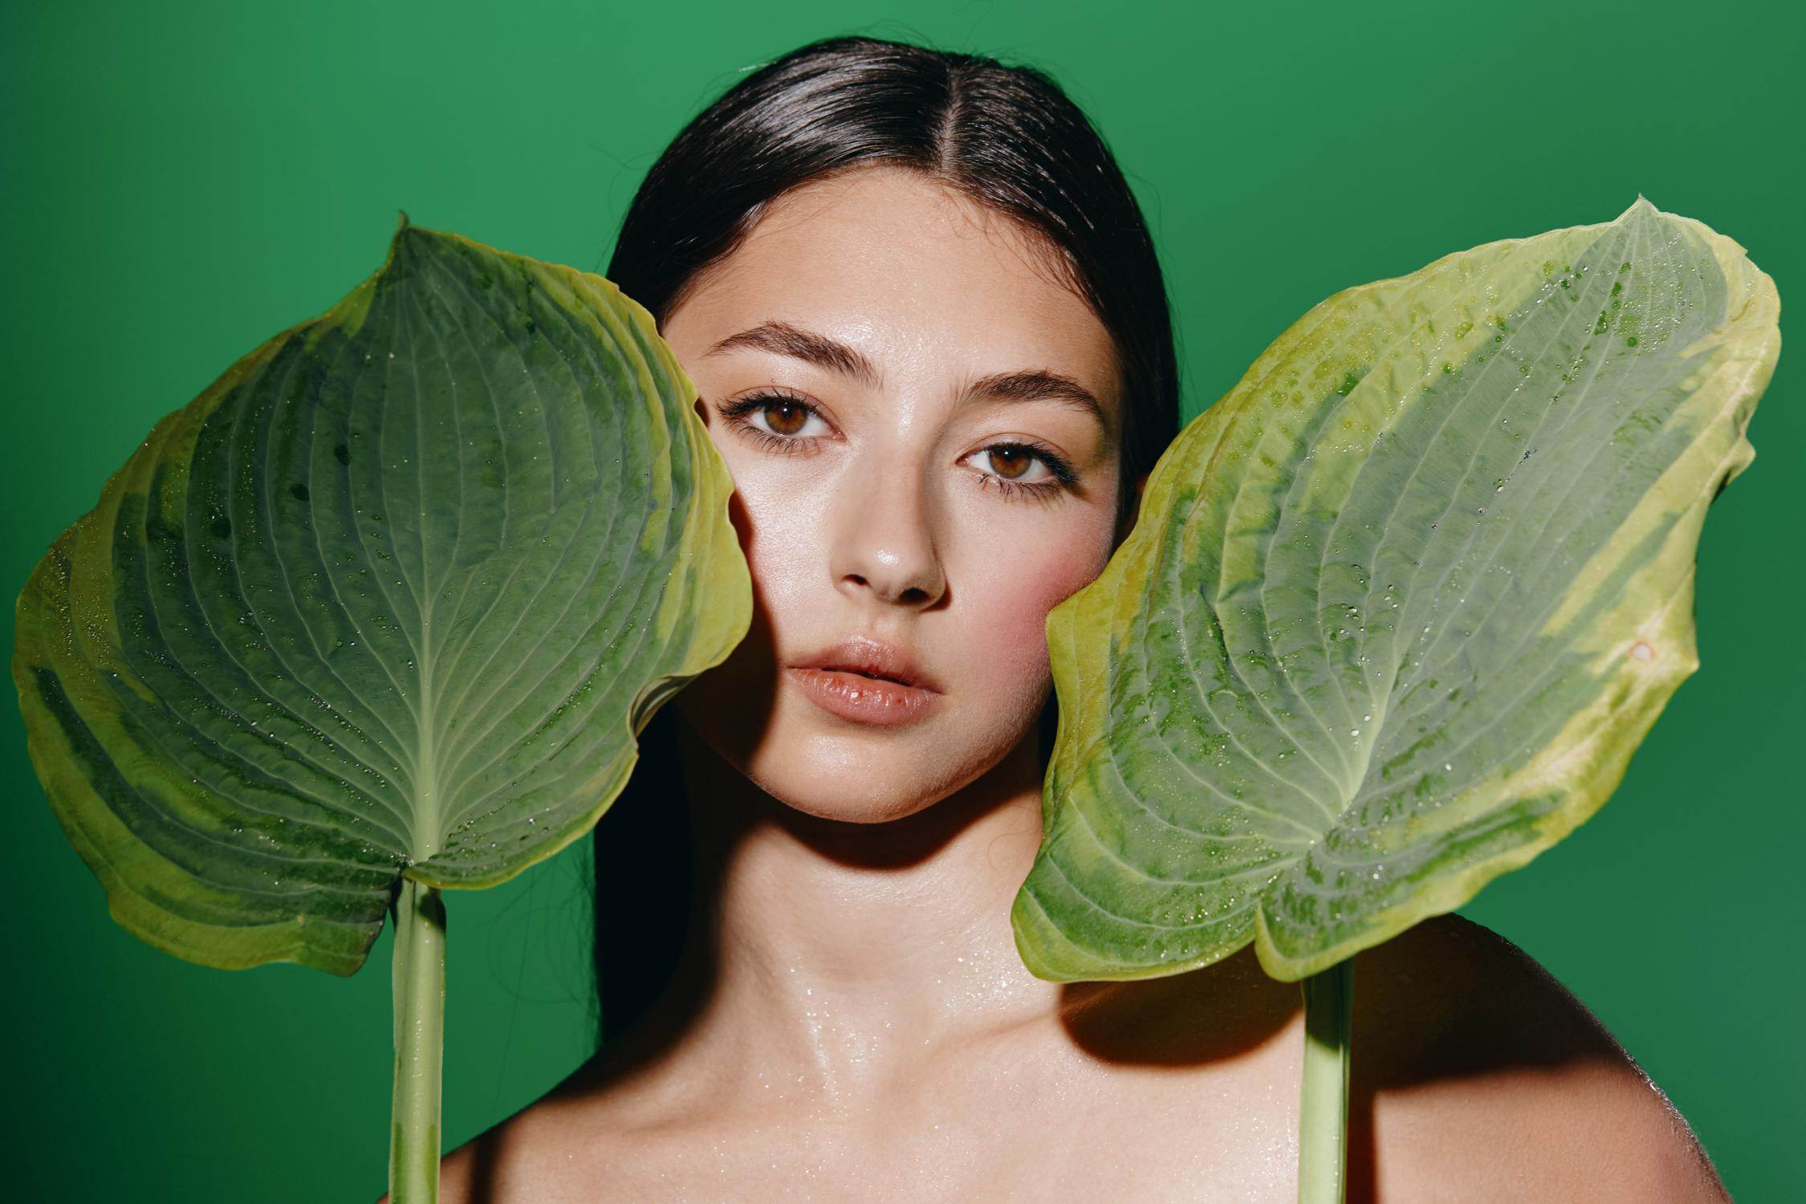
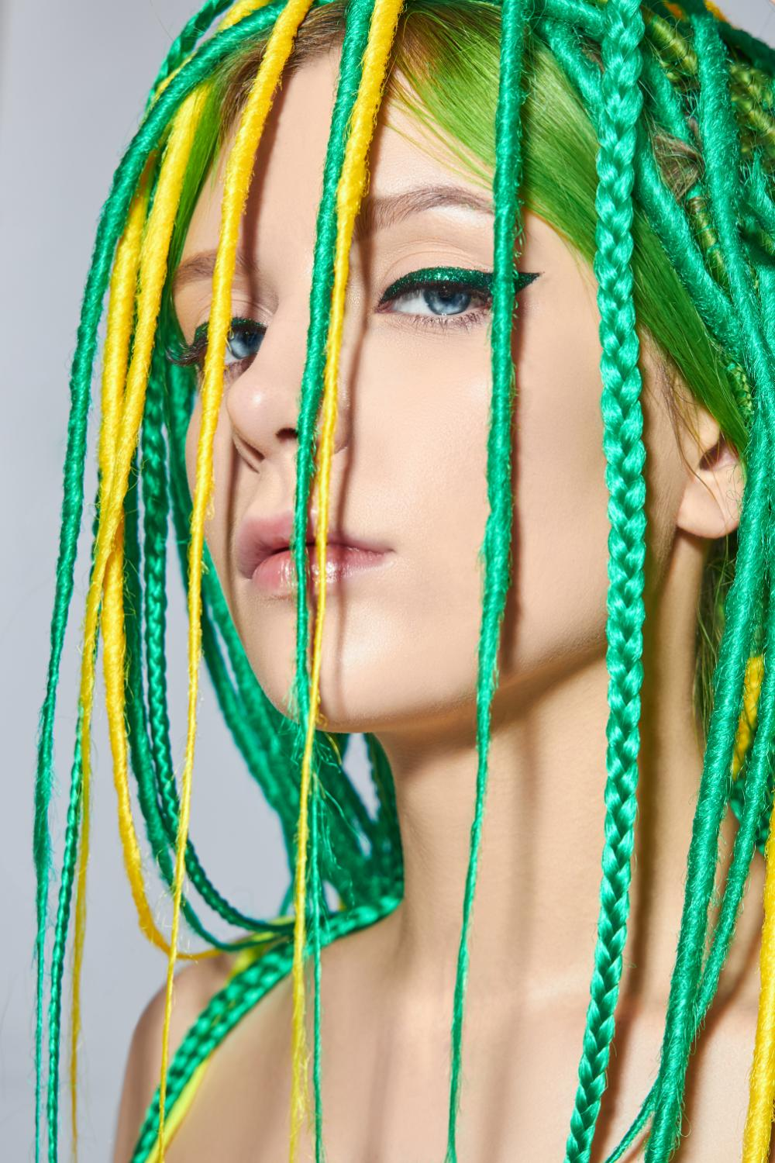
Helping New Commerce To Enter Into Modeling Industry
At 7DaysChic, we support new businesses entering the modeling industry, creating diverse opportunities for models to thrive. Partner with us to access a dynamic range of projects and contribute to an innovative modeling ecosystem.

Slide 14
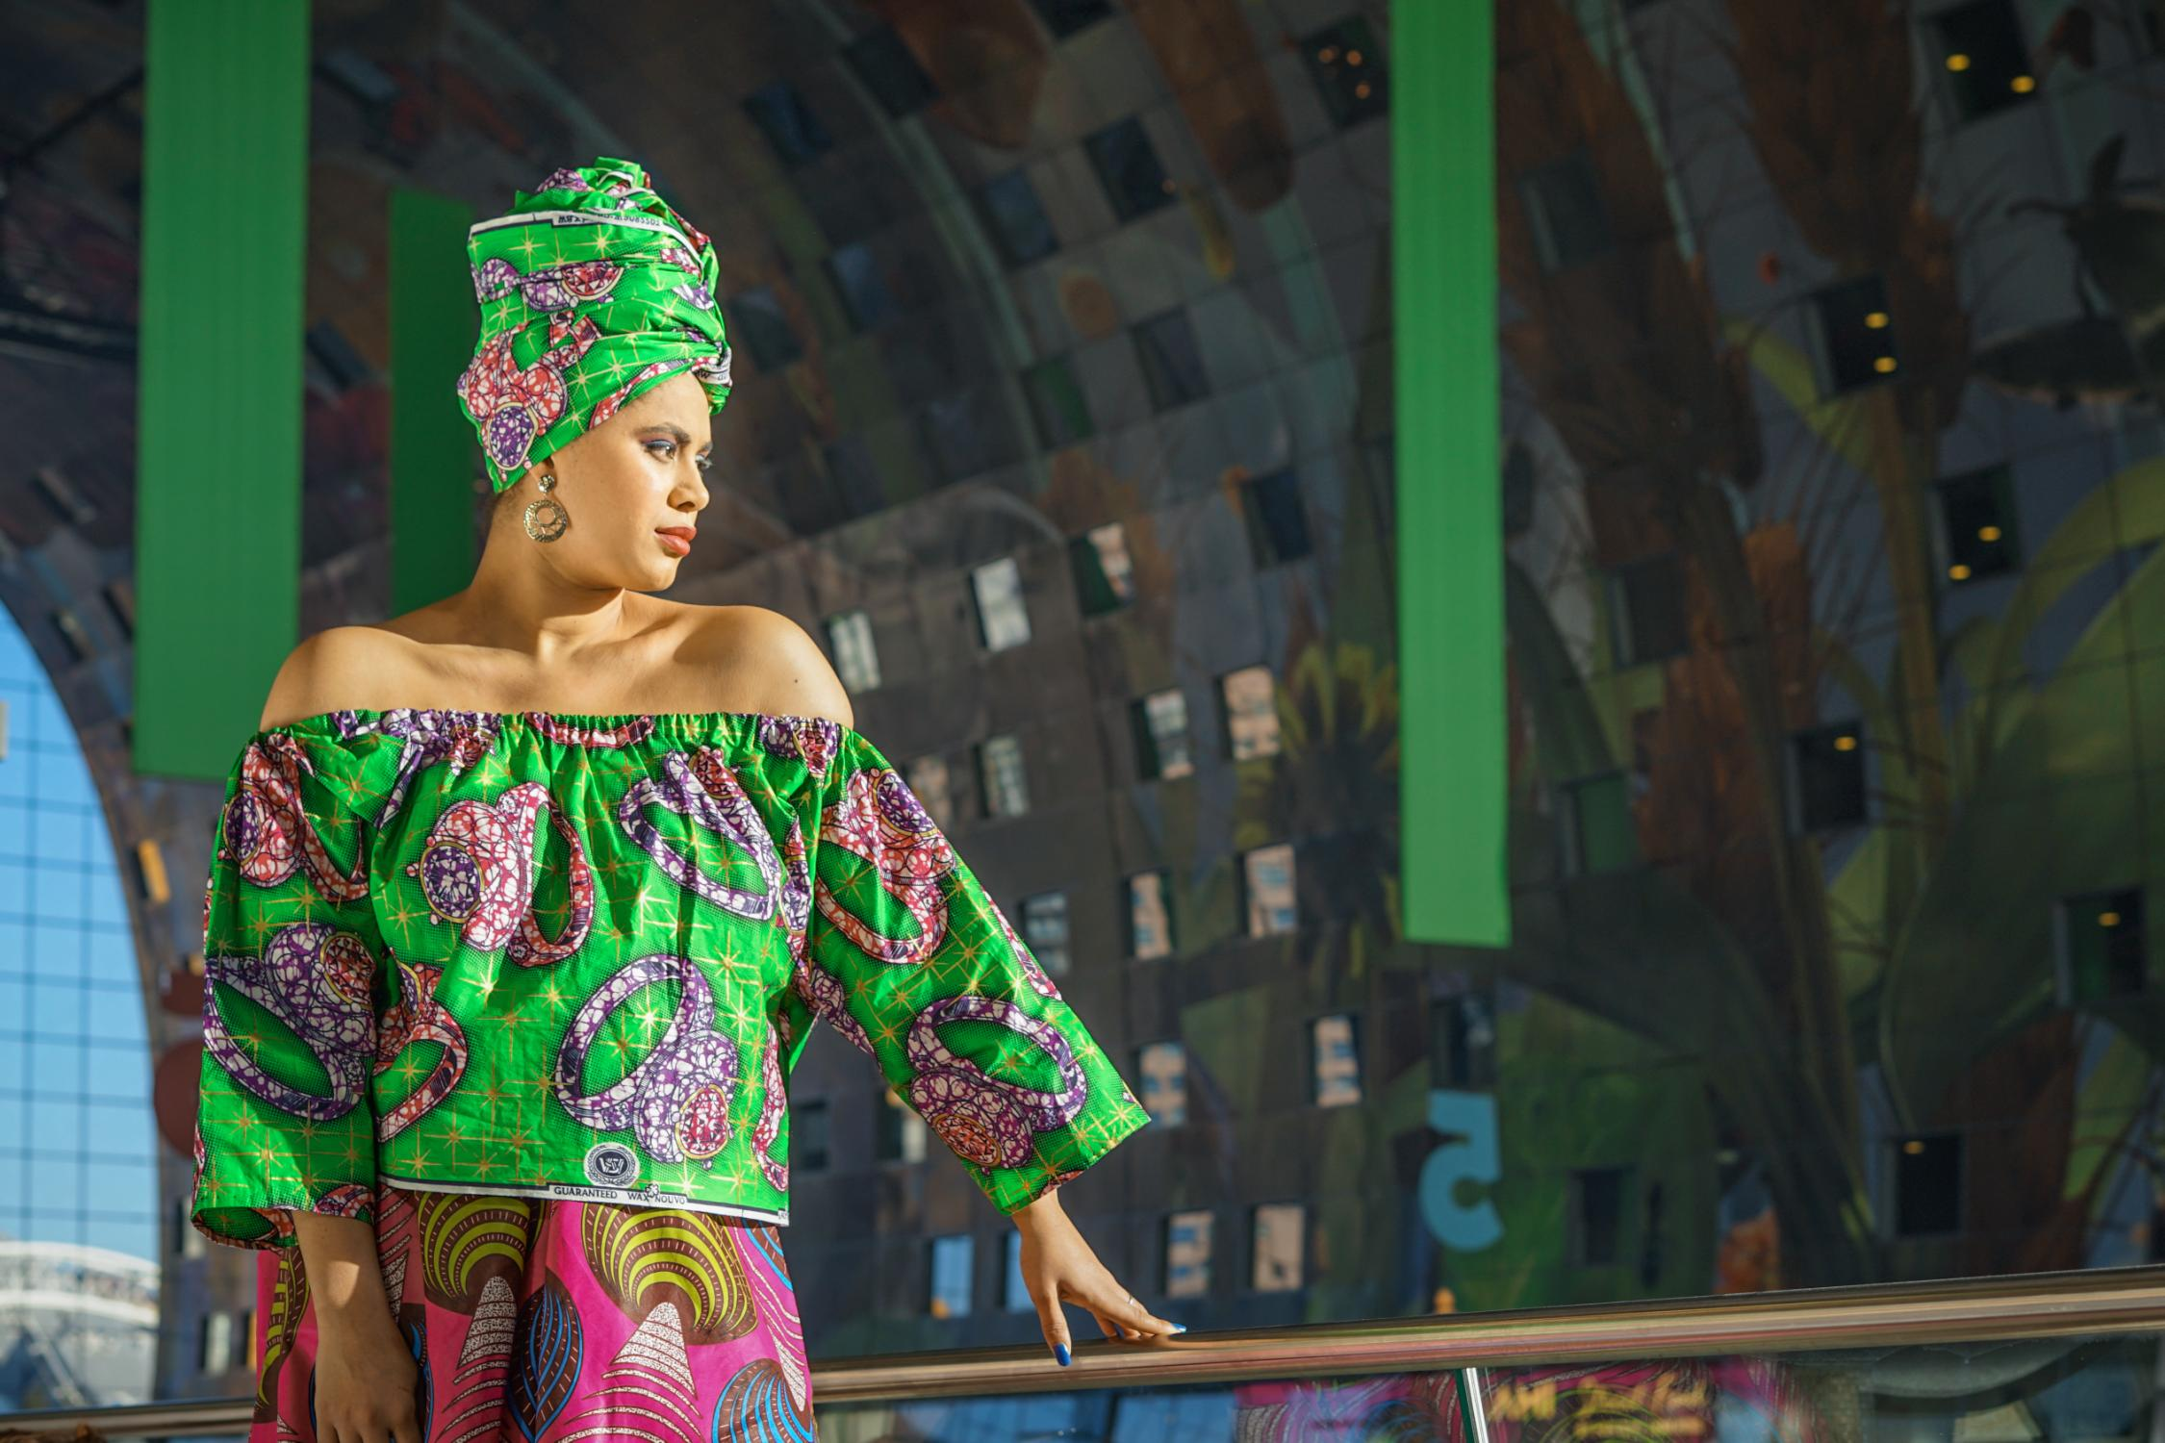
“Personal-Branding” And “Profile-Promotion
At 7DaysChic, we specialize in "Personal Branding" and "Profile Promotion," crucial for models to stand out and succeed in the fashion industry. Partner with us to shape your unique image, attract opportunities, and enhance your career trajectory.

Slide 15
We have the exclusive Industry Access. Over 60% of our models have secured job opportunities through our networking events.
We have the exexellent Social Media Strategy: Models we've assisted have seen a 70% increase in their social media following within six months.
We ensures your portfolio stands out in the competitive industry. Models who have worked with us have seen a 40% increase in positive agency responses
Our network includes connections with leading agencies like Elite, Ford, and IMG, increasing your chances of representation by 35%.
Why choose us

Slide 16
We have the exclusive Industry Access. Over 60% of our models have secured job opportunities through our networking events.
We have the exexellent Social Media Strategy: Models we've assisted have seen a 70% increase in their social media following within six months.
We ensures your portfolio stands out in the competitive industry. Models who have worked with us have seen a 40% increase in positive agency responses
Our network includes connections with leading agencies like Elite, Ford, and IMG, increasing your chances of representation by 35%.

Slide 17
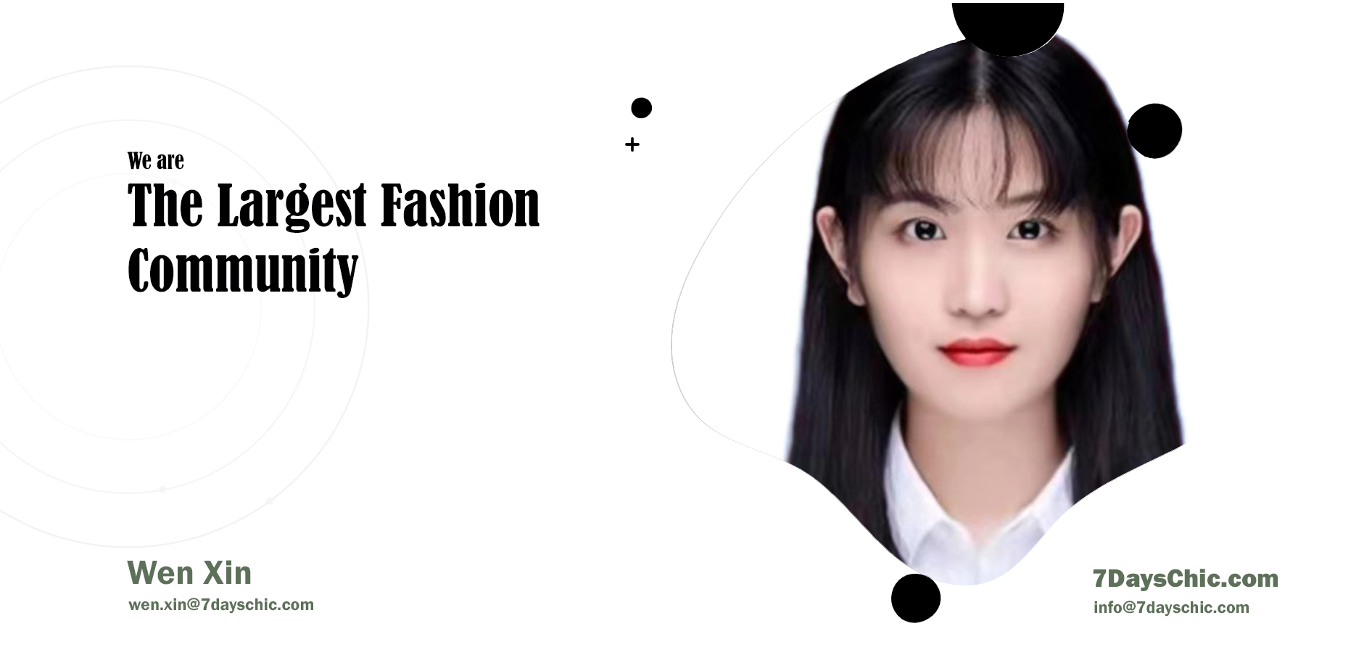

THANK YOU
Contact us
Email:wen.xin@7dayschic.com
Address:2nd Floor College House, 17 King Edwards Road, Ruislip, London, United Kingdom, HA4 7AE
Website:https://7dayschic.com/
Ins:@7dayschiccom.

